Slide 1
MongoDB with python
UWIZEYE Delphine

Slide 2
content
Review
Getting started with python
Performing CRUD operations

Slide 3
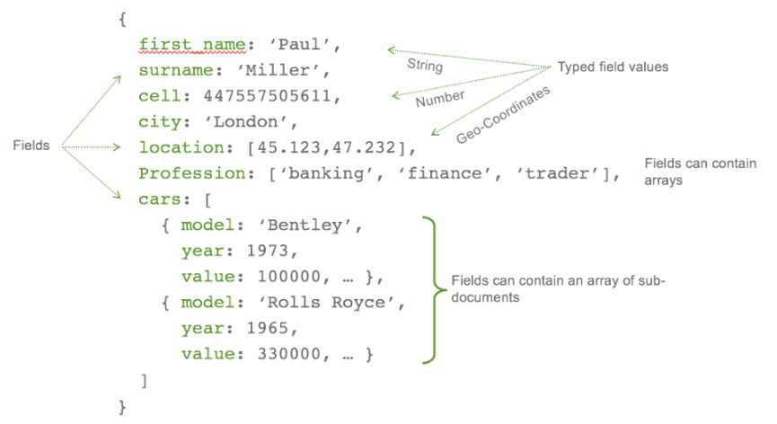
MongoDB with python
MongoDB
a document-oriented NoSQL database used for high volume data storage
Stores data in JSON-like documents
Inside databases there are collections, each collection may have many documents; and each document may have many field.
Has no stable scheme of data

Slide 4


Getting stared with python
For connecting mongoDB with python, python driver is needed to make that connection.
Install the python driver “pymongo” by “pip install pymongo”
mongoClient class help to establish a connection to mongodb with Pymongo.
We have first to make a connection between mongoDB with pymongo

Slide 5
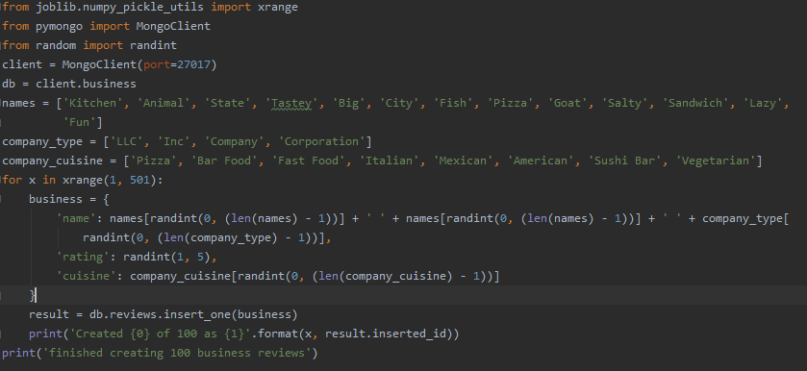
Performing CRUD operations
creating some data in mongodb using pymongo database: business collection: review
db =client.business : creates database called business
db.reviews : create a collection called reviews

Slide 6
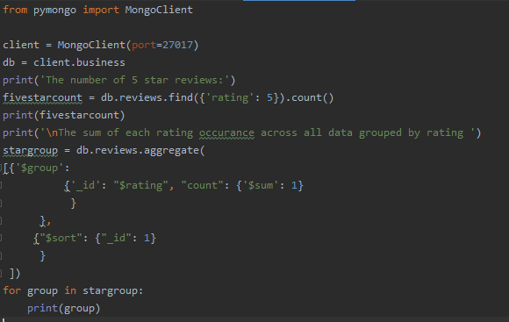
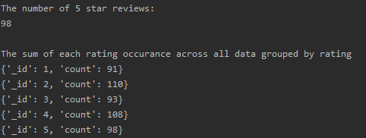
Performing CRUD operations
We may execute many queries and print the results in mongodb by simply using MongoDB aggregation pipeline
Aggregation pipeline: an array of different operations or stages.

Slide 7
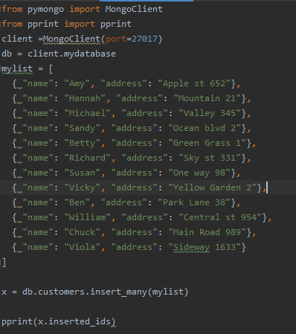
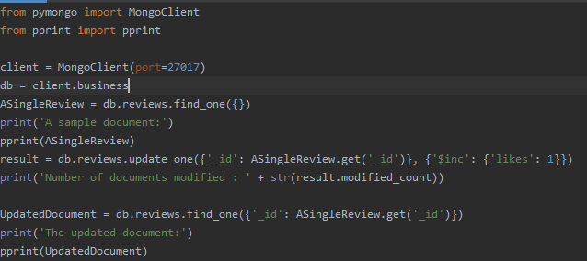
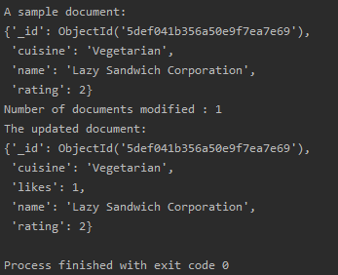
Performing CRUD operations Updating data with Pymongo
You may use: insert_one, insert_many, update_one, update_many,
replace_one, delete_many,… for updating the data in mongodb.
inserting many documents at a time
by updating, a new field(likes)
has created.

Slide 8
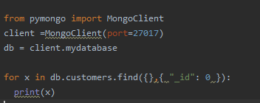
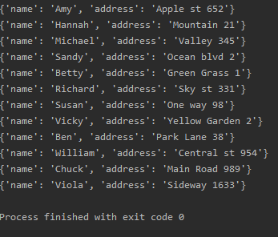
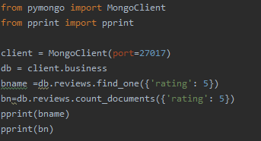
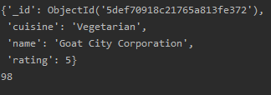
CRUD operations In mongodb we use find_one(), or find() command for selecting documents. you may do everything you want with your MongoDB data through python!

